Slide 1

Department of Computer Science And Engineering
JAWAHARLAL NEHRU TECHNOLOGICAL UNIVERSITY HYDERABAD
UNIVERSITY COLLEGE OF ENGINEERING HYDERABAD
Kukatpally, Hyderabad, Telangana (India) - 500 085.
DISSERTATION WORK REVIEW I
Selective Bridge ROI Enhancement Using Intelligent Frame Selection for UAV Flights
PRESENTED BY
GUIDE:
P. Gnana Laya Reddy (22011P0507)
B.Tech-IDP, 5th Year I Semester CSE, JNTUH UCEH
DR. K. P. SUPREETHI
Professor, CSE
JNTUH UCEH

Slide 2
TABLE OF CONTENTS
S. No. | Section
1 | Abstract
2 | Introduction
3 | Problem Statement & Justification
4 | Related Papers
4 | Implementation Plan
5 | Proposed Work/ Flow Diagram
8 | Expected Outcomes & Conclusion
9 | References

Slide 3
ABSTRACT
UAVs provide a rapid and non-contact method of bridge and infrastructure inspection.
However, UAV video frames frequently contain redundant views, irrelevant background, motion blur, compression artifacts, illumination variation, and insufficient spatial resolution.
Existing image-enhancement methods primarily optimize visual / perceptual quality, and enhancement does not necessarily imply better engineering-defect detection.
This research proposes an infrastructure-aware, defect-preserving enhancement framework for UAV inspection.
The framework will perform:
Intelligent frame selection
Bridge ROI extraction
ROI-based Defect-preserving enhancement/super-resolution
Enhancement methods will be evaluated not only using conventional image-quality metrics but also through their impact on downstream crack detection.

Slide 4
INTRODUCTION
Why UAV-based inspection?
UAVs enable rapid inspection of bridges and other difficult-to-access infrastructure.
A single flight can generate hundreds/thousands of images or video frames.
Computer vision can automate detection of surface defects such as cracks.
The problem with UAV imagery
Raw UAV frames are not necessarily suitable for automated inspection because of:
Motion blur, Low spatial resolution, Illumination variation, Perspective changes, Background/irrelevant objects, Large numbers of visually redundant frames
Critical observation
Multi-Frame Persistence: Cracks appear across multiple consecutive video frames.
Low Pixel Resolution: Cracks occupy a very small fraction of pixels in each original frame.
RESEARCH PROBLEM
How to identify and enhance micro cracks across sequential UAV video frames, without distorting the authentic structure of the defect.

Slide 5
PROBLEM STATEMENT
Given a UAV inspection video of a bridge, develop an intelligent preprocessing and image-enhancement framework that selects informative non-redundant frames, isolates the bridge surface, evaluates ROI image quality, and enhances defect-relevant information without introducing or destroying crack characteristics.
Specific Challenges to Address
Challenge | Effect
Redundant Frames | Unnecessary computations
Low Spatial Resolution | Hairline Cracks are ignored
Illumination variations | Reduces crack / background contrast
Motion blur | Weakens crack boundaries
Lack of task-oriented evaluation | Focus on detection performance than visual quality

Slide 6
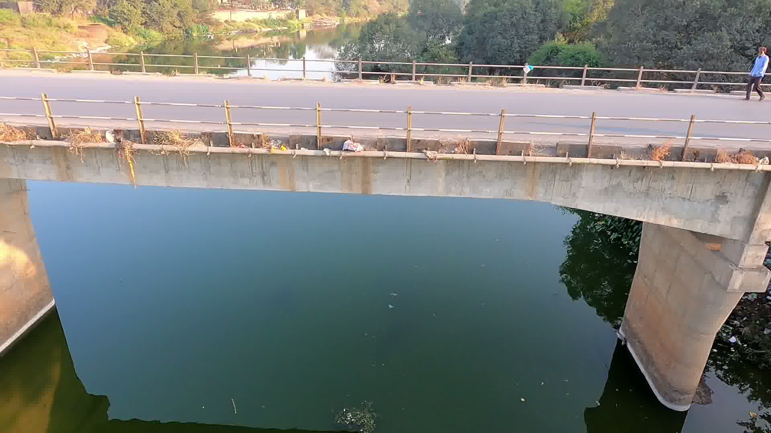
Frame 25
Redundant Frames

Slide 7
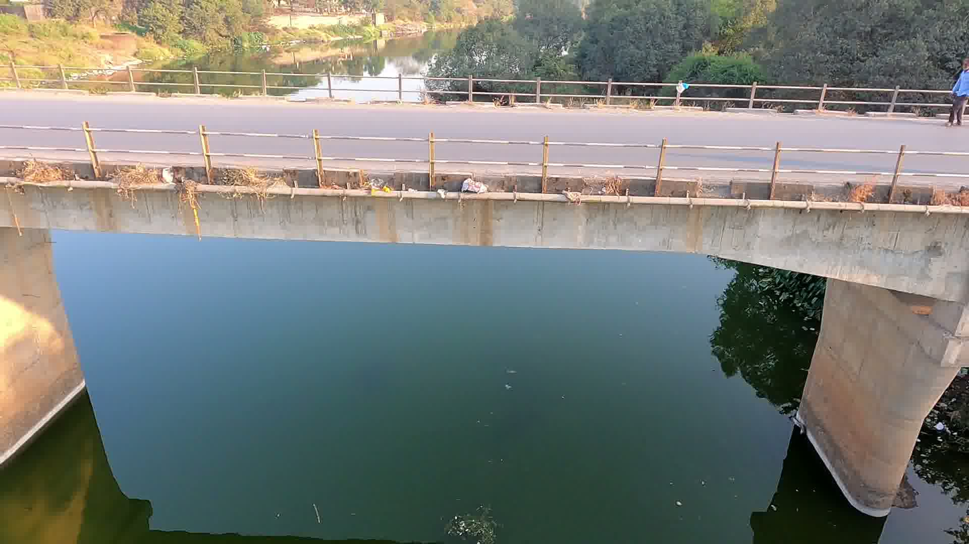
Frame 26
Redundant Frames

Slide 8
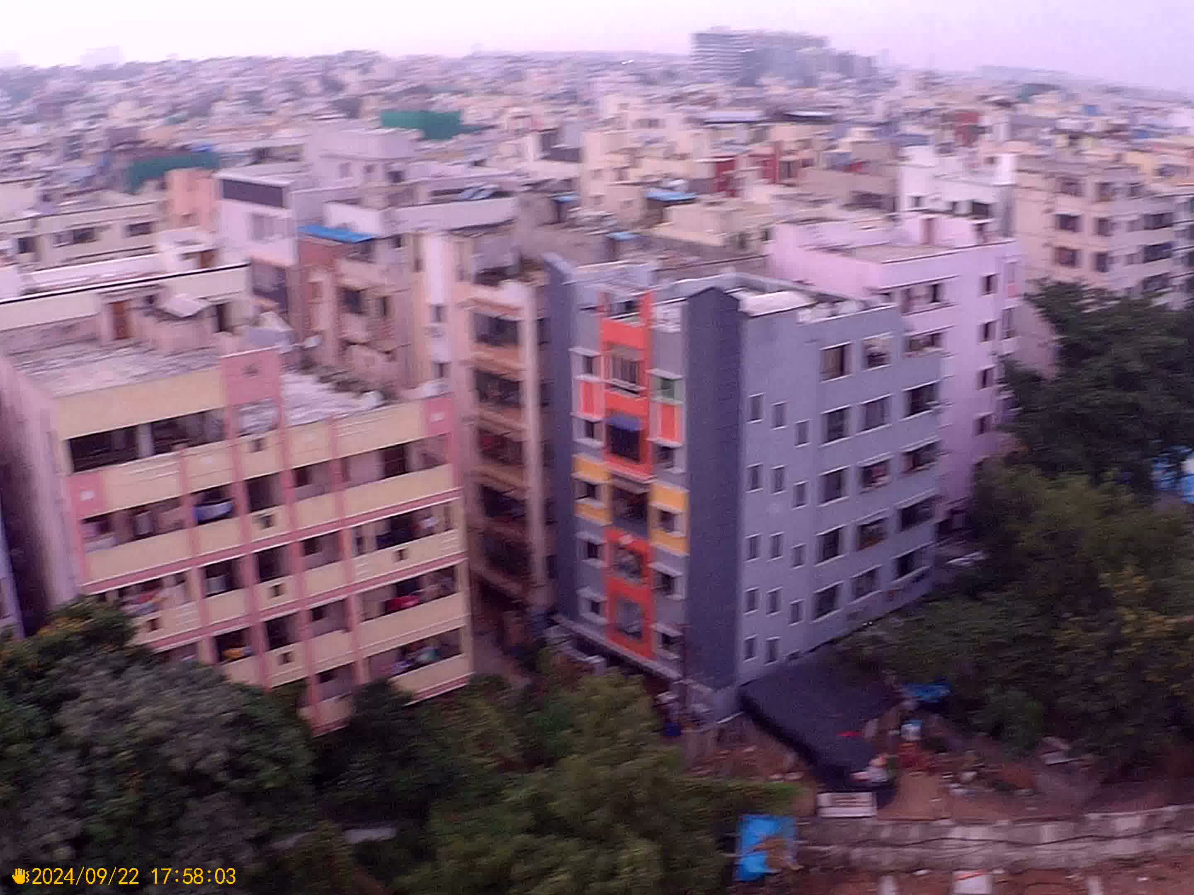
Motion Blur

Slide 9
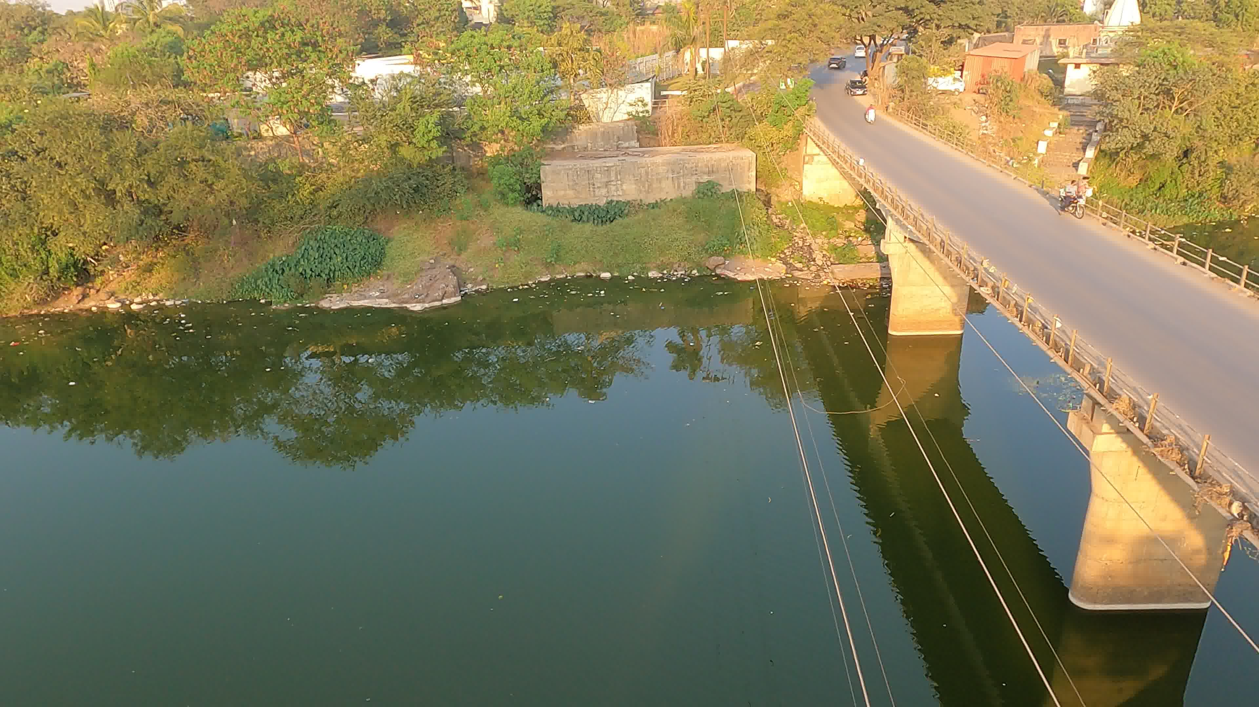
Irrelevant Background

Slide 10
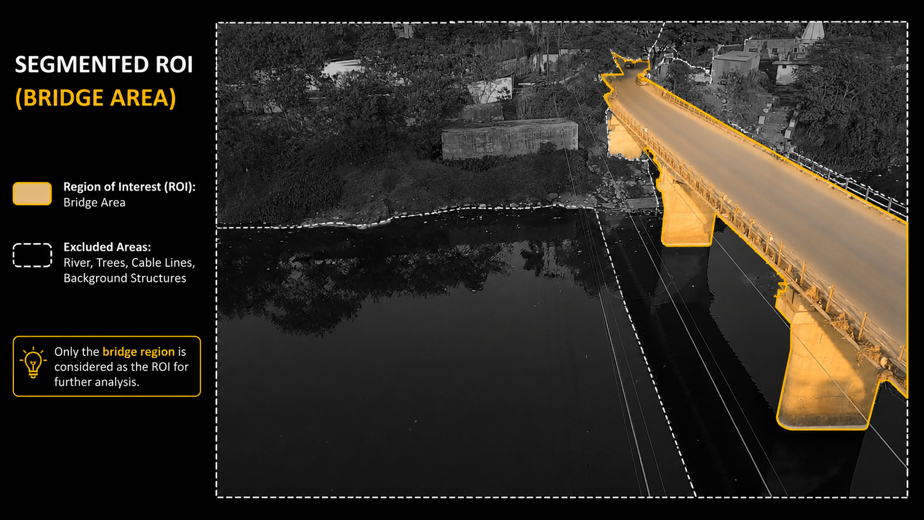

Slide 11
RELATED PAPERS
Paper | Relevance to Project
Exploring the Potential of Super-Resolution for Crack Analysis in UAV Facade Orthomosaics of Small Bridges (2025) | Evaluates FSRCNN, SRGAN, Real-ESRGAN and SwinIR for improving crack analysis in UAV bridge facade orthomosaics. It demonstrates that super-resolution can substantially improve quantitative crack-width and crack-length measurements.
Guided Super-Resolution for Image Fusion: A Novel Approach to Enhancing Crack Segmentation in Masonry Structures (2025) | Investigates whether super-resolution can improve crack segmentation and proposes RGB-guided SR using high-resolution RGB information to reconstruct lower-resolution IR information
Task-Driven Super Resolution for Improved Crack Segmentation in Low-Resolution Imagery (2024) | Instead of treating SR only as visual enhancement, the work focuses on improving the downstream crack-segmentation task.
Crack detection algorithm for concrete structures based on super-resolution reconstruction and segmentation network(2022) | Uses deep-learning super-resolution before semantic crack segmentation for images affected by UAV motion blur and insufficient resolution. The study reports improvements in crack segmentation and crack-length/width quantification after SR.

Slide 12
IMPLEMENTATION PLAN
Develop an infrastructure-aware defect-preserving enhancement pipeline for UAV bridge inspection.
Proposed stages
UAV Video
Frame Extraction
Intelligent Frame Selection
Bridge ROI Detection
ROI-based Image Quality Assessment
Defect-Preserving Image Enhancement
Enhanced Bridge ROI
Crack Detection / Segmentation
Task-oriented Evaluation

Slide 13
PROPOSED WORK / FLOW DIAGRAM
1.UAV Video And Frame Extraction
2. Intelligent frame selection.
3.Bridge ROI Detection
Input of video data From UAV. Extracting individual frames from the video stream.
Selecting relevant frames for the analysis
Identifying the region of interest on the bridge.
5. Crack detection/ Segmentation
4.ROI-based Defect- Preserving Enhancement
Enhancing the image while preserving defect details. Resulting processed image of the bridge region.
Detecting and segmenting cracks in Enhanced image.

Slide 14
EXPECTED OUTCOMES
Reduced frame redundancy - Fewer frames requiring computational processing.
Improved inspection relevance - Background and irrelevant regions removed before enhancement.
ROI-aware Improved visibility of fine defects - Image quality measured specifically on bridge surfaces and Better identification of crack boundaries and local contrast.
Defect-preserving enhancement - Minimized hallucination, disappearance, or distortion of crack structures.
CONCLUSION
UAV imagery provides an efficient source for automated infrastructure inspection but contains significant redundancy and image-quality limitations.
Conventional enhancement methods may improve visual appearance without necessarily preserving engineering-critical defects.
The ultimate objective is to establish an inspection-oriented enhancement methodology, where image enhancement is considered successful only when it preserves or improves structural-defect information.

Slide 15
REFERENCES
1. Jang, D. and Park, H. and Jeon, E, Exploring the Potential of Super-Resolution for Crack Analysis in UAV Facade Orthomosaics of Small Bridges, The International Archives of the Photogrammetry, Remote Sensing and Spatial Information Sciences, XLVIII-2/W11-2025, 2025, 139--144
5. Z. Wang, J. Chen and S. C. H. Hoi, "Deep Learning for Image Super-Resolution: A Survey," in IEEE Transactions on Pattern Analysis and Machine Intelligence, vol. 43, no. 10, pp. 3365-3387, 1 Oct. 2021, doi: 10.1109/TPAMI.2020.2982166.
2. Y. Fang, L. Fan and Y. Cai, "Guided Super-Resolution for Image Fusion: A Novel Approach to Enhancing Crack Segmentation in Masonry Structures," in IEEE Sensors Journal, vol. 25, no. 7, pp. 11491-11507, 1 April1, 2025, doi: 10.1109/JSEN.2025.3540119
6. Xu, Z.; Wang, Y.; Hao, X.; Fan, J. Crack Detection of Bridge Concrete Components Based on Large-Scene Images Using an Unmanned Aerial Vehicle. Sensors 2023, 23, 6271.
3. R. Hou and X. Xu, "Task-Driven Super Resolution for Improved Crack Segmentation in Low-Resolution Imagery," 2024 43rd Chinese Control Conference (CCC), Kunming, China, 2024, pp. 7588-7595
7. M. Haris, T. Watanabe, L. Fan, M. R. Widyanto and H. Nobuhara, "Superresolution for UAV Images via Adaptive Multiple Sparse Representation and Its Application to 3-D Reconstruction," in IEEE Transactions on Geoscience and Remote Sensing, vol. 55, no. 7, pp. 4047-4058, July 2017
4. Chao Xiang, Wei Wang, Lu Deng, Peng Shi, Xuan Kong, “Crack detection algorithm for concrete structures based on super-resolution reconstruction and segmentation network”, Automation in Construction, Volume 140, 2022, 104346, ISSN 0926-5805,

Slide 16
THANK YOU

